Slide 1



FINAL WORK
Umidjon Sattorov(student at Skillbox platform)
sattorov7474@gmail.com

Slide 2

CONTENT
01
Business problem
02
Data analysis and preparation
03
Answering data analysis questions
04
Feature engineering
05
Training model

Slide 3

BUSINESS PROBLEM
01
Hyphothesis testing
1) Organic traffic is no different from paid traiffic in terms of Conversion Rate(CR) to target events
2) Traffic from mobile devices is no different from traffic from desktop devices in terms of CR(Conversion Rate) into target events
02
Analytical questions
1)From which source/campaigns/devices/locations does the most targeted traffic come to us(both in terms of traffic volume and in terms of view CR)?
2)Which cars are in the greatest demand? Which cars have the best CR(Conversion Rate) for targeted events?
03
Machine learning model
Classification model for determining whether user in SberBankAuto website performed targeted actions like : 'sub_car_claim_click', sub_car_claim_submit_click', 'sub_open_dialog_click', sub_custom_question_submit_click' and so on.

Slide 4

DATA ANALYSIS
For the step data analysis and preparation, I have done following tasks.
Decision-making for empty data
Saving resources
After quick initial analysis, I have found huge amount of empty values. Therefore I have accomplished some correlation analysis for making correct decision about the fate of these columns.
After analysis and preparatory work in the dataset, I have reduced the number of unique values in some columns for saving computing resources.
Uploading
Correlations
Cleaning
Size reducing
ANALYSIS
Initial analysis
Filling missing values and cleaning data
Firstly, I have uploaded file to jupyter notebook and do some quick analysis work.(Checking the emptyness of columns and value distribution.)
After correlation analysis, I have dropped columns which has tremendous amount of empty values and removed the columns which doesn’t have great correlation with targeted columns. Moreover, I have filled up missing values of some columns if possible.

Slide 5
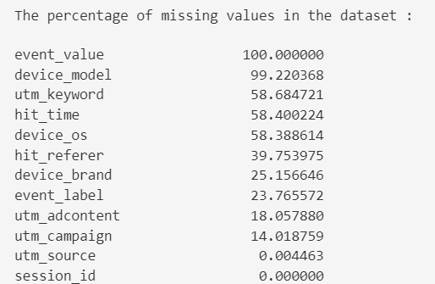
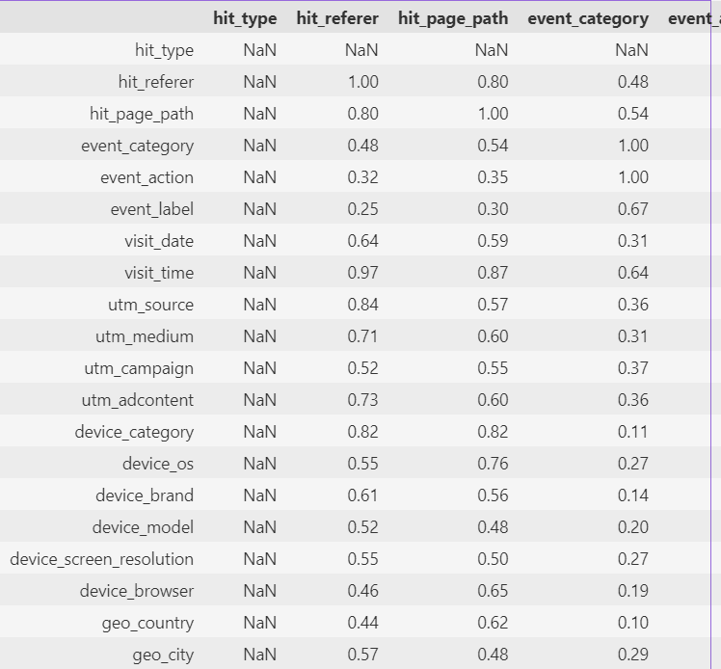
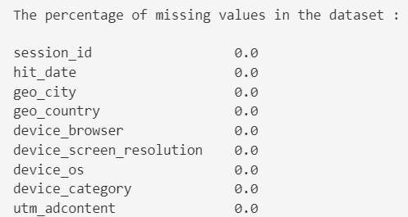
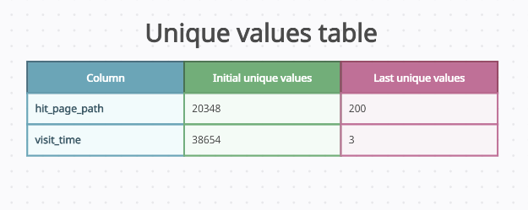
DATA ANALYSIS AND PREPARATION
Correlations
Uploading
Cleaning
Size reducing

Slide 6
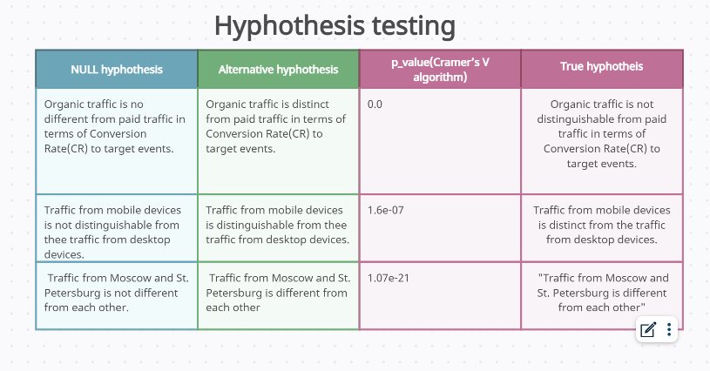
ANSWERING DATA ANALYSIS QUESTIONS
Hyphothesis analysis
In order to test the hyphothesis for probability, I have used Cramer’s V algorithm.

Slide 7
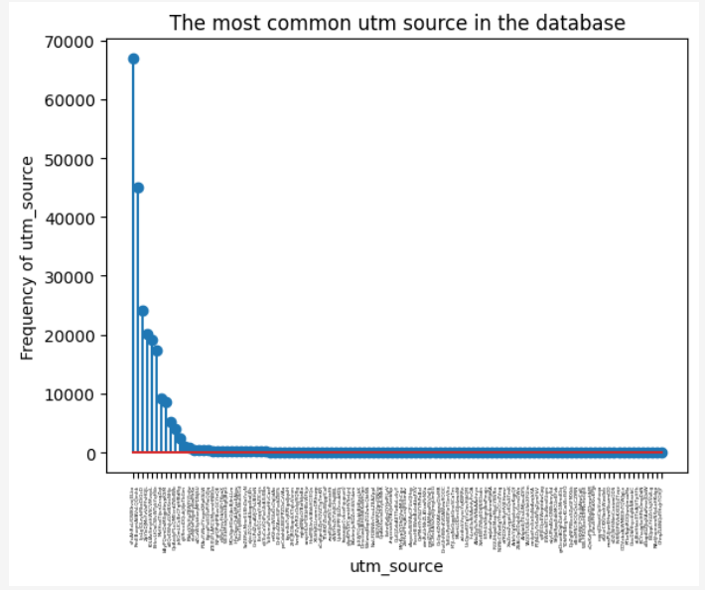
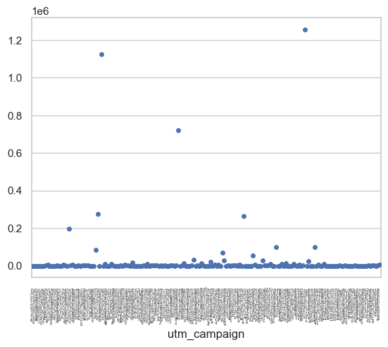
ANSWERING DATA ANALYSIS QUESTIONS
Most common utm_source
Most common utm_campaign
From the little stem chart, we can easily infer that the prevalent source of utm which the traffic come from is
From the given scatter plot, we can easily conclude that the most traffic to the website is come from okTXSMadDkjvntEHzIjp
vFcAhRxLfOWKhvxjELkx

Slide 8
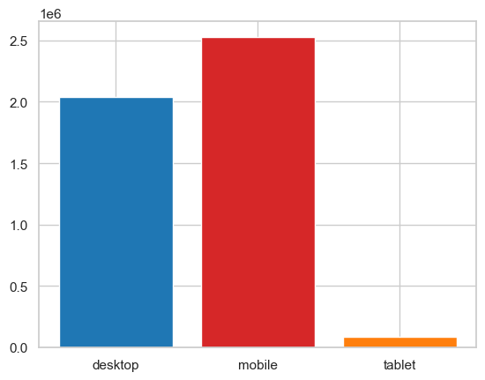
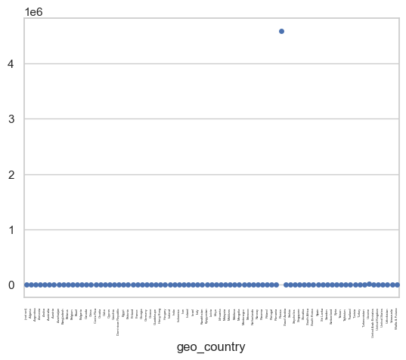
ANSWERING DATA ANALYSIS QUESTIONS
Most common device
Most common country
Given bar chart represents that mobile devices were the dominant category of technology which users used when accessing the website.
Scatter plot illustrates that the most people to the car renting website were the Russian residents.

Slide 9
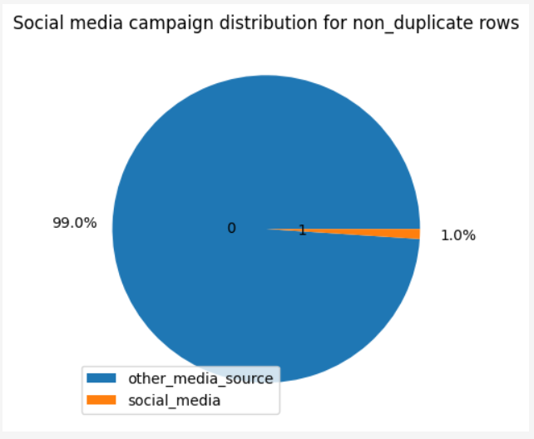
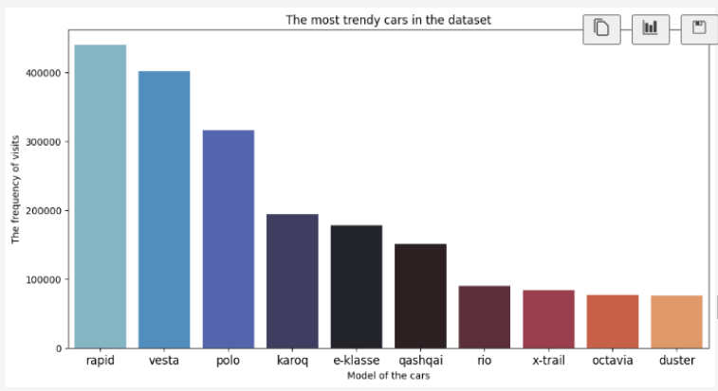
ANSWERING DATA ANALYSIS QUESTIONS
The most demanded cars
Do the company need to invest to social media campaign?
Bar chart indicates that the most trendy model of cars which was rented by website users were rapid and vesta.
As the contribution of social media to overall traffic to the website doesn’t comprise huge percentage, it is better to invest to other marketing campaigns.

Slide 10
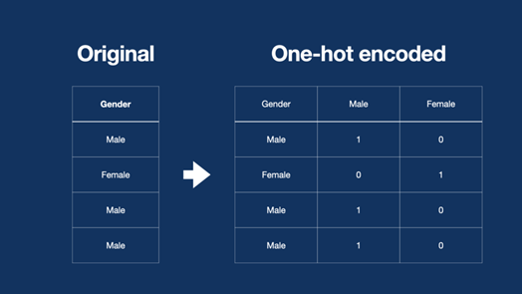

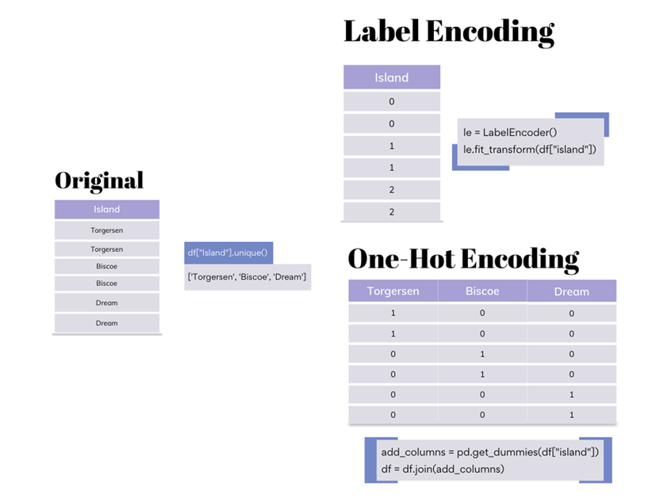
FEATURE ENGINEERING
One Hot encoder:
For this stage, I have replaced the values of table data to binary form using One Hot encoder. But before that, In order to avoid using extra columns, I have diminished the number of cols.
In these stage of modelling, I have transformed the dataset by reducing the number of excessive columns and then do some feature engineering tasks.
Standart scaler:
After using One hot encoder to categorical values, I have used Standart scaler for the values of numerical columns.
Label encoder:
For the purpose of avoiding excessive usage of columns in resulting machine learning model, I ahev use Label encoder to reduce the number of unique values.

Slide 11
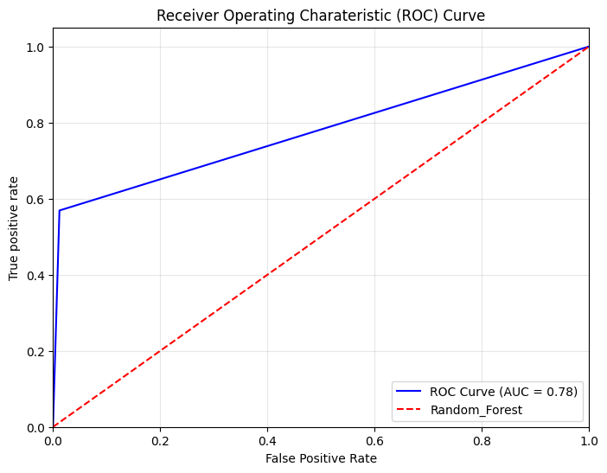
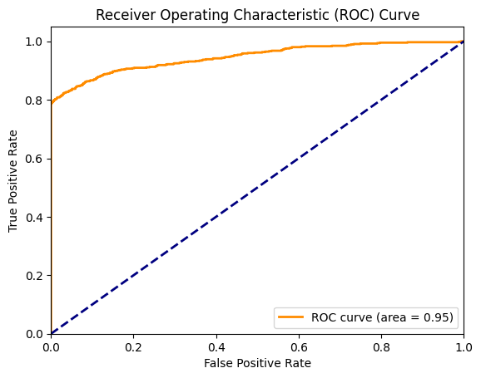
TRAINING MACHINE LEARNING MODEL
Tabular model of fastai
Random Forest Model
This machine learning model performed well in the given task and returned 0.78 auc metric. The model is trained with over 200000 data from the dataset.
This machine learning model performed far better than Random forest and demonstrated 0.95 auc metric. The model is trained using only 3% of the data and test with other 100000 data.

Slide 12

THANK YOU
FOR YOUR ATTENTION
Umidjon Sattorov(student at Skillbox platform)
sattorov7474@gmail.com

